Slide 1
CZ3006
Part I - Tutorial 3

Slide 2


Q1: Ethernet: Minimum Frame Size Requirement
A round trip signal propagation time + the processing time is the minimum transmission requirement for a frame transmission to ensure a proper detection of a collision.
200 m
We must consider the “worst” case.

Slide 3
Q1: Minimum Frame Size
Minimum frame size (tx. time)
= 2 x end-to-end signal propagation time
+ processing time (negligible)
End-to-end signal propagation time
= 5 x delay in segment + 4 x delay in each repeater
200 m

Slide 4
Q1: Minimum Frame Size
Minimum frame size (tx. time)
= 2 x end-to-end signal propagation time
+ processing time (negligible)
End-to-end signal propagation time
= 5 x delay in segment + 4 x delay in each repeater
36us
8us
2us
2us
10us
> Given that signal prop. time is 1us for every 100m
Delay per segment = 200 / 100 = 2 us
> Given that the delay in each repeater = 2 us

Slide 5
Q1: Minimum Frame Size
Minimum frame size (tx. time) = 36 us
at 20Mb/s, for a time period of 36 us, the number of bits can be transmitted is:
36us x 20Mb/s
= 720 bits

Slide 6
Q2:Binary Exponential Backoff (BEB)
PROBLEM:
Three stations involved in a collision in an attempt to access an Ethernet LAN. Calculate the probability that the next event on the channel is also a collision.
hub
Next event can be either:
a successful transmission
or
a collision.

Slide 7
Q2:Binary Exponential Backoff (BEB)
collision
time
possible retransmission time
(slot 0 or slot 1)
collision detected
transmission started
Probability that the next event is also a collision:
= Prob (All choose slot 0 or 1) + Prob (Two choose slot 0)
= Prob (A=0, B=0, C=0) + Prob (A=1, B=1, C=1)
+ Prob (A=1, B=0, C=0) + Prob (A=0, B=1, C=0)
+ Prob (A=0, B=0, C=1)
= (0.5 x 0.5 x 0.5) x 5 (since A, B, & C are independent)
= 0.625

Slide 8
Question 3
In a local area network using the CSMA/CD protocol, a modified Binary Exponential Backoff scheme is used if a collision is detected in the channel. Assume that two stations (A and B) are transmitting and their frames collide in one time slot. Each of them will retransmit its data frame over a window of size 2 slots. Station A retransmits in slot 0 with probability of p and station B retransmits in slot 0 with probability of q.
If p = 1/3 and q = 2/3, what is the probability that the first event in the channel will be a success?
How would you maximize the probability that the first event in the channel will be a success, by choosing proper values for p and q?

Slide 9
Q3 answer
A
p
B
q
0
1

Slide 10
Q3(i) answer
 | A | B | Probability | Success?
 | 0 | 0 | pq
 | 0 | 1 | p(1-q) | Yes
 | 1 | 0 | (1-p)q | Yes
 | 1 | 1 | (1-p)(1-q)
p = 1/3, q = 2/3
Pr( first event is success) = p(1-q)+(1-p)q
= 1/3*1/3 + 2/3 *2/3
= 5/9

Slide 11
Q3(ii) answer
 | A | B | Probability | Success?
 | 0 | 0 | pq
 | 0 | 1 | p(1-q) | Yes
 | 1 | 0 | (1-p)q | Yes
 | 1 | 1 | (1-p)(1-q)
Pr( first event is success) = p(1-q)+(1-p)q
minimize pq + (1-p)(1-q) is achieved when
pq =0 and (1-p)(1-q) =0
To maximize the throughput, one can choose
p = 0, q =1, or
p =1 , q = 0

Slide 12
Question 4
Suppose that an 11-Mbps 802.11b WLAN is transmitting 64-byte frames back-to-back over a radio channel with a bit error rate of 10 ⁻⁷. How many frames per second will be damaged on average?

Slide 13
Q4 Answer
A frame contains 512 bits. The bit error rate is p = 10⁻⁷. The probability of all 512 of them surviving correctly is (1 − p)⁵¹², which is about 0.9999488. The fraction damaged is thus about 5 × 10⁻⁵. The number of frames per second is 11 × 10⁶ / 512 or about 21,484. Multiplying these two numbers together, we get about 1 damaged frame per second.
Taylor expansion:
(1 − p)⁵¹² ≈ 1-p*512 = 1- 10⁻⁷ *512 = 0.9999488

Slide 14
Question 5
You are commissioned to design an experimental wireless network for SCE to support its 100 wireless devices. You have decided to adopt a multi-access reservation protocol (MARP) for frame transmission in the data link layer. Specifically, each transmission cycle consists of two phases: a reservation phase and a transmission phase. In the reservation phase, a chosen MAC protocol is used for transmission stations to reserve the channel; and in the transmission phase, the station that successfully reserves the channel transmits one frame. The data rate in the wireless channel is 1 Mbps. The length of the data frame is 1000 bits, among which the reservation frame carries 10 information bits.

Slide 15
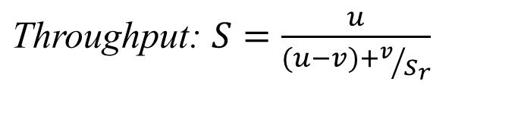
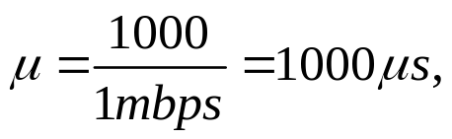
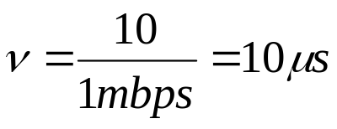
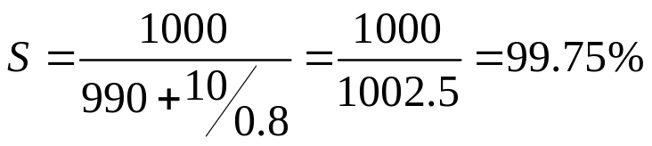
Q5(i) Answer
(i) If the MAC protocol used in the reservation phase has a utilization of 0.8, what will be the throughput of the MARP?
Phase 1: Reservation
Phase 2: Transmission
μ - v
v
S_{r}=0.8

Slide 16
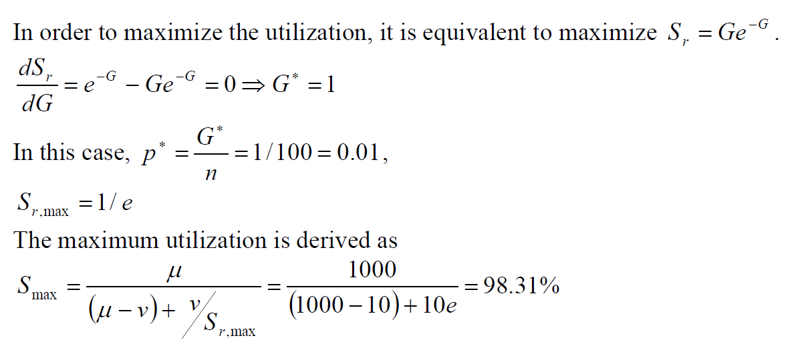
Q5(ii) Answer
(ii) Assume that the slotted Aloha protocol is used in the reservation phase. The utilization for the slotted Aloha protocol is Ge^{-G}, where G = np, n is the number of stations, and p is transmission probability. Calculate an optimal transmission probability to maximize the throughput of the MARP, and the corresponding maximum throughput?

